Slide 1
Advanced Excel
Calculations and Customization
© 2007 West Virginia University / Silverman

Slide 2
Advanced Excel
AVERAGE, COUNTIF, MAX, & MEDIAN Functions (Handout Pages 4-5)
IF Function
Relative & Absolute Addressing
Conditional Formatting

Slide 3
Download the Workbook
Please download the companion file to this presentation at the following URL: http://oit.wvu.edu/training/classmat/xl
Right click the following link and select “Save Target As”:
Advanced Excel Examples workbook file (.xls)
Click “Save” & “Open”

Slide 4
Simulation Exercise
We are going to use Excel to simulate tracking readings from a scientific instrument over time.
We will apply functions to our recorded readings.
We will use the “IF” function and logical operators to identify thresholds of alerts.
We will also use Conditional Formatting to make certain readings stand out from others

Slide 5
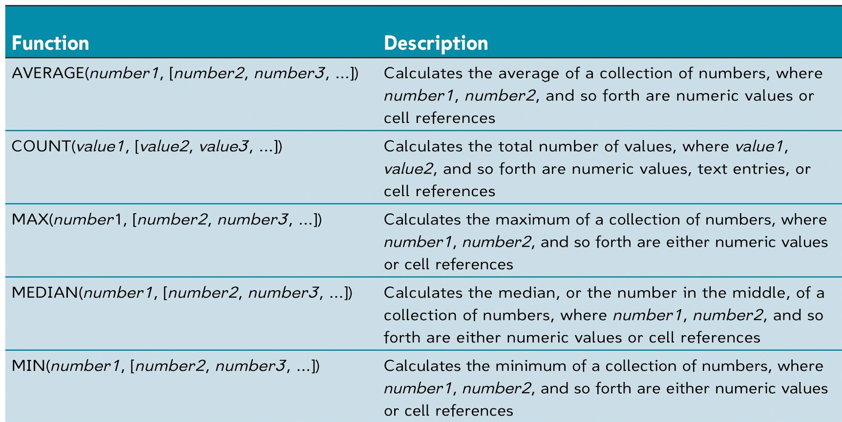
Common Functions

Slide 6
Add in Some Functions
Insert the appropriate functions for the following…
Use the “Point” method to select the range of numbers in the “B” Column:
Enter the functions with the ranges into these cells: [B13] [B14] [B15] …

Slide 7
“IF” Function & Logical Operators
Structure is:
=IF(logical_test,value_if_true,value_if_false)
Valid Comparison Operators:
“Equal” A1=B1
“Greater Than” A1>B1
“Less Than” A1<B1
“Greater or Equal” A1>=B1
“Less or Equal” A1<=B1
“Not Equal” A1<>B1

Slide 8
Using an IF Function
We want to make a visual alert for anytime our instrument readings exceed a certain threshold.
Let’s start with “100” being the danger level
…

Slide 9
Making Our Comparison
Type the following :
[B17] 100
[C2] =IF(B2>=B17,"Yes","No")

Slide 10
Copying a Function w/ Fill Handle
Copy C2 to C3:C11
Didn’t give the correct answers, Right??
Let’s look at what values changed from C2 as we copied it down…
Click [C3] and notice while we wanted it to reference [B3], which it did, we did not want it to move away from [B17] for the warning threshold and it did…

Slide 11
Relative & Absolute References
We need an Absolute Reference to lock things to cell B17
The “$” locks the Column, Row, or Both…
$B$17 is “Full Absolute”
When copying, neither Column nor Row references may change

Slide 12
Let’s fix it!
Edit the contents of [C2] in the formula bar:
We will leave [B2] as Relative Addressing by not adding any $ symbols…
Change to an absolute reference $B$17
Recopy using the fill handle

Slide 13
COUNTIF Function
Evaluates a range for a condition and provides number of cells meeting the condition
Format is:
=COUNTIF(range,”condition”)
Type the following in cell B19:
=COUNTIF(C2:C11,”Yes”)
Make B19 background Red (Handout Page 9)

Slide 14
Conditional Formatting
Used to change a cells appearance when a specified condition is met.
Often used to change font or background color
Select C2:C11
Click “Format” above and select “Conditional Formatting”…

Slide 15
Conditional Formatting
Change “between” to be “equal to”
Type the following in the box to the right:
=“Yes”
Click “Format” and Select “Patterns” tab
Click the bright red color and click “OK” twice

Slide 16
Additional Conditional Formatting
Let’s add a second condition!
Select C2:C11
Format… Conditional Formatting
Click “Add >>”
Change “Between” to “equal to”…

Slide 17
Adding a Second Condition
Type the following in the space:
=“No”
Click “Format”.
Select Green and press “OK” Twice.

Slide 18
Let’s Change the Warning Level
The agency we work for just released a bulletin that said the dangerous level threshold has now reduced to “42”.
Change the value in [B17] to be 42
Notice the changes and additionally highlighted areas!

Slide 19
Advanced Excel
Commenting (Handout Page 11)
Inserting a Hyperlink
AutoFormat (Handout Page 8)

Slide 20
Commenting Cells
You can insert comments into a spread sheet so that they can be revealed like a screen tip when do a mouse over on the commented cell…
Right click [A17] and select “Insert Comment”
Type “This represents the value of the threshold for a hazardous level”
Click away, notice the red triangle and do a mouse over on [A17] to see the comment

Slide 21
Inserting a Hyperlink
Can be useful for many reasons…
Links to related organizations
E-mail addresses of clients
For our purposes, let’s put a link to the Center for Disease Control’s web site where we might find needed, current numbers…

Slide 22
Inserting a Hyperlink
Select cell [A21]
Click “Insert” above and select “Hyperlink”
In “Text to display:” type:
CDC Site
In “Address:” type:
http://www.cdc.gov
Try your link!

Slide 23
AutoFormat
Click the “Format” menu
Select “AutoFormat”
Select “Classic 3”

Slide 24
Advanced Excel
PMT Function (Handout Page 5)
Goal Seek (Handout Page 7)
Naming a Cell (Handout Page 6)

Slide 25
Buying a House Example
We can use PMT and Goal Seek to help determine if it is something we can afford.
PMT is the Payment function
Goal Seek helps us find an unknown value by manipulating a related value

Slide 26
Mortgage Calculator
Type 100,000 in [B1] for value of house
Type 5,000 in [B2] for down payment
(SKIP over Financed for now)
Type .06 in [B4] for % interest rate
Type 30 in [B5] for years
…

Slide 27

Naming a Cell
Select cell [B1]
Click “Insert”, “Name”, “Define”
Type House and click “OK”
This cell can now be referenced as either “B1” or “House” in our functions and formulas!
…

Slide 28
House Payment
Type the following in [B3] to get financed amount:
=House-B2
Type the following in [B6] for # of payments:
=B5*12

Slide 29
Using PMT to get the Monthly
Format is:
=PMT(interest/12, payments, -financed)
Type the following in [B7]
=PMT(B4/12,B6,-B3)
We should see $569.57 per month for 360 months for a non-escrowed mortgage payment…

Slide 30
Let’s change this a bit…
Leave price and money down the same
Change from 30 year to 15 year period
We see the payment go up to $801.66 / month
Change the interest rate to .05 in [B4] as 15 years is commonly a lower interest rate than 30…

Slide 31
30 Years vs. 15 Years
We see the payment become $751.25 for half the amount of time / Payments!
The end result is in the 30 year model, we would end up paying $569.57 * 360 payments which gives us $205,045.20 over the life of the loan…

Slide 32
30 Years vs. 15 Years
The 15 year model gives us $751.25 * 180 payments for a total of $135,225.00
The savings of the 15 year over the 30 year is $69,820.20 !
Paying and extra $181.68 a month would seem to be worth it if the budget allows.

Slide 33
Goal Seek
Allows for a kind of “What If” scenario
Allows setting a target number and it will manipulate another number to temporarily see what it would take to reach a given target.
Let’s say we need to get our monthly payment down to $675 and we need to know how much to put down to make that happen…

Slide 34
Goal Seek
Make [B7] the active cell
Click “Tools” and select “Goal Seek”
Enter 675 for “To Value:”
Set “By changing cell:” to B2
We learn we would need to make a down payment of $14,642.71 or an additional $9642.71
Click OK to keep… Cancel to revert.

Slide 35
Making it pretty…
Change A1 to have white font on black background
Use Format painter to make A2:A7 the same appearance
Add borders around the values in the B column (Page 9)
Format… Cells… Border
Add a picture!

Slide 36
Advanced Excel
Trendlines for forecasting the future
Finding the line of best fit
Showing the equation
Plugging the equation back in
Extending the line forward graphically

Slide 37

ALLIGATORS!!
Some Interesting Facts…
You can estimate length easily by measuring from tip of the mouth to the eyes… For every 1 inch there, assume 1 foot of length.
Mouths have tremendous closing power and little opening power.
Hard to tell what they weigh!

Slide 38
Alligators…
Select A5:B29 and go to chart wizard
Select XY Scatter… Next…. Next
Title Chart “Alligator Data Nonlinear”
Value (X) Axis “Length in Inches”
Value (Y) Axis “Weight in Pounds”

Slide 39
Alligators
Let’s add a Trendline!
Right click one of the points on the chart
Click “Add Trendline”
Identify a line of best fit…
Linear? Try it? Does it look like the points? No!
Try another one…

Slide 40
Alligators
Right click on trendline…
Click “Format trendline” and select “Type”
Try “Exponential”… That isn’t bad!

Slide 41
Alligators
Let’s have Excel display this equation on the trendline!
Go back to “Format Trendline” and select the options tab.
Check “Display equation on chart”

Slide 42
Alligators
We see: y=3.8013e^{0.0354x}
We can use this to predict the future values we do not yet have in B30:B32…
To get our “Y” which is Weight, we need to be able to convert this equation into a format that can be used in an excel spreadsheet…

Slide 43
Alligators…
In Cell B30 which is “Y”, we start to convert the equation y=3.8013e^{0.0354x}
Type in: =3.8013*2.718^(0.0354*A30)
2.718 is a known constant value for “e”…
The ^ symbol shows and exponent…
A30 is our “X” value…
Let’s see the results!

Slide 44
Alligators
We get “716.229” pound 148 inch Gator !
Copy it down to B31 and B32 to get predictions on Alligators 149 and 150 inches long.

Slide 45
Another Way
It is also possible to have Excel give us the future statistics by extending the line on the chart forward
Let’s go back to the trendline properties options & forecast forward by 3
The result should appear to be 150” and 768 pounds !
© 2007 West Virginia University / Silverman

